Slide 1
Case Study of The Killer Robot
Presented By:
- Anil Acharya
- Roshan Jaiswal
- Sambhawi Paudel
- Shasank Shrestha

Slide 2
Table of Contents
Case study of The Killer Robot
Culprits
Outline
Cast of Characters
Randy Samuels
Sam Reynolds
Ray Johnson
Cindy Yardley
Michael Waterson
GUI Designer
Summary
Main Culprit
Causes of Incident

Slide 3
Culprits
Case study of The Killer Robot
Cast of Characters
Table of Contents
Table of Contents
Summary
Outline
Main Culprit
Cause of Incident

Slide 4
Outline
Fictitious case written by Richard Epstein.
Presented as collection of news stories, reports, and interviews.
Case includes aspects of computer ethics and software engineering.
Talk about programmer psychology, teamwork, interfaces, software process models, and software testing.

Slide 5
Cast of Characters
Cybernetics Inc.
Silicon Techtronics
Bill Park
(Physics Professor)
Horace Gritty
(Computer Science Professor)
Bart Matthews
(Robot Operator)
Michael Waterson
(President and CEO)
Jane Anderson
(Former Programmer Analyst)
Jane Mc Murdock
(Prosecuting Attorney)
Ray Johnson
(Robotics Division Chief)
Max Worthington
(Chief Security Officer)
Ruth Witherspoon
(Programmer-Analyst)
Sandra Henderson
(Assisted in Q.A)
Sam Reynolds
(CX30 Project Manager)
Sharon Skinner
(Software Psychology Professor)
Randy Samuels
(Programmer)
Cindy Yardley
(Software Tester)
Interface designer
Harry Yoder
(Computer Technology and Ethics Professor)

Slide 6
Summary
Robbie CX30 malfunction and killed Bart Matthews.
Randy Samuels wrote the false code.
Team of project Robbie CX30 were in tremendous pressure.
Silicon Techtronics were in a tight financial position.
Lack of cooperation between the team members.

Slide 7
Causes of Incident
Waterfall model was used in developing software.
Programmer misinterpreted the physics formula.
Part of the software that caused the malfunction was stolen.
Software test was faked.
GUI was poorly designed.

Slide 8


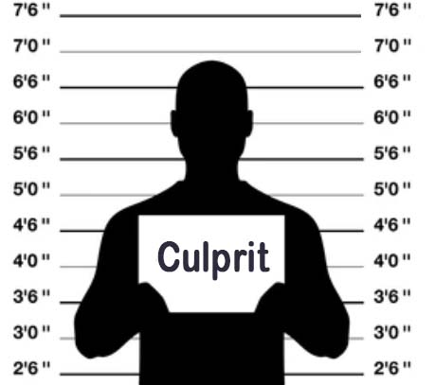
Culprits
1) Michael Waterson
(President and CEO)
2) Ray Johnson
(Robotics Division Chief)
3) Sam Reynolds
(CX30 P.Manager)
5) Cindy Yardley
(Software Tester)
4) Randy Samuels
(Programmer)
6) Interface designer

Slide 9




Randy Samuels
Randy programmed the Robbie CX30.
Misread a handwritten formula for a robot's dynamic behavior
Could not cooperate with teammates
Against ACM Code
1.5 Violated the right of others
2.4 Did not respond well to feedback
Against BCS Code
2.f Had carelessness in his code
2.e Did not respond well to feedback from peers

Slide 10
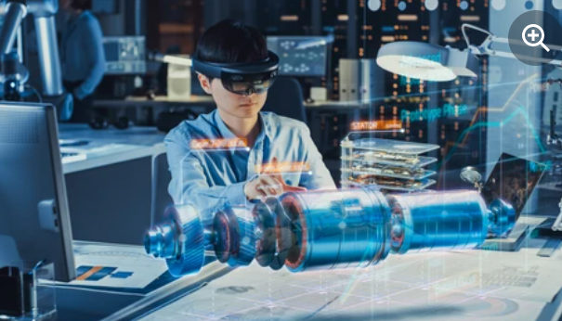


Ray Johnson
Robotics Division chief at Silicon Techtronic
Bringing an emotional or personal conflict into a work setting (Sam Reynolds)
Placing a lot of pressure on the team
Against ACM Code
2.1 Encouraged his subordinates to take shortcuts
2.5 Used risky solutions
Against BCS Code
1.a failed to consider public safety
3.e He falsely claimed that his product was error-free

Slide 11




Sam Reynolds
CX30 project manager (made by CEO Michael)
Forced the waterfall model to be used rather than the robot-friendly prototype model
Lack of communication with Ray
Against ACM Code
2.4 Did not respond well to feedback
2.6 accepted a work for which he was ineligible
Against BCS Code
2.e He rejected criticism and opposing views
3.a Unauthorized usage of power

Slide 12

Main Culprit
For us the main culprit is,
Ray Johnson

Slide 13
Crime
Bringing emotional and personal feud into a professional environment.
ACM Code of Conduct
BCS Code of Conduct
3.6 Create opportunities for members of the organization and group to learn, respect, and be accountable.
4. Duty to the Profession
d) Act with integrity and respect in your professional relationships with all members

Slide 14
Crime
Placing a lot of pressure on team members.
ACM Code of Conduct
BCS Code of Conduct
1.1 Contribute to society and to human well-being, acknowledging that all people are stakeholders in computing.
4. Duty to the Profession
f) Encourage and support fellow members in their professional development.

Slide 15
Crime
Wanted his subordinates to cut corners.
.
ACM Code of Conduct
BCS Code of Conduct
2.2 Maintain high standards of professional competence, conduct, and ethical practice.

Slide 16
Crime
Manipulated Cindy to perform fake test on Samuel’s software.
ACM Code of Conduct
BCS Code of Conduct
2.4 Accept and provide appropriate professional review.
2. Professional Competence and Integrity
g) Reject and will not make any offer of bribery or unethical inducement.

Slide 17
Crime
Getting flawed software out the door to customers on time.
ACM Code of Conduct
BCS Code of Conduct
2.1 Strive to achieve the highest quality in professional work.
3. Duty to Relevant Authority
g) Carry out your professional responsibilities with due care and diligence.

